Slide 1
Classes and Methods
Computer Engineering Department
Java Course
Assoc. Prof. Dr. Ahmet Sayar
Kocaeli University - Fall 2019

Slide 2
Defining Classes
A class contains data declarations (state) and method declarations (behaviors)
class Baby
String name;
Double weight;
Char sex;
Data declarations
Method declarations

Slide 3
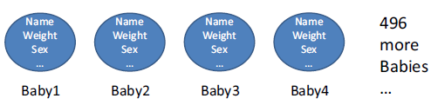
Why use classes?

Slide 4
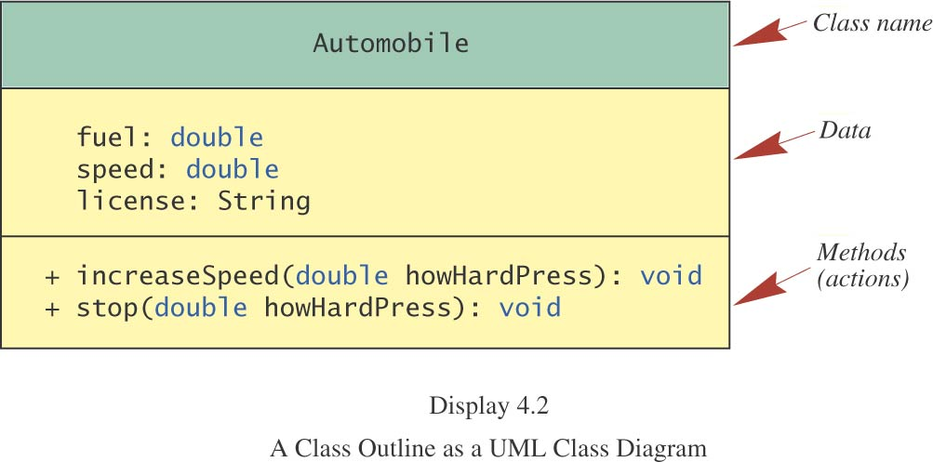
A UML Class Diagram

Slide 5
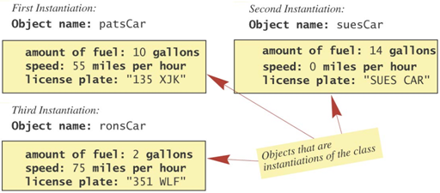
Class – Object Instances

Slide 6
Constructors I
Class instances are created with constructors
Constructor name == the class name
No return type – never returns anything
Usually initialize fields
All classes need at least one constructor
If you don’t write one, defaults to
There might be more than one constructors

Slide 7
Constructors II
CLASSNAME {
CLASSNAME (){ }
CLASSNAME ([arguments]){
……
}
}
CLASSNAME obj1 = new CLASSNAME();
CLASSNAME obj1 = new CLASSNAME([arguments]);

Slide 8
Automobile Constructor
Automobile(double f, double s, String l){
fuel=f;
speed=s;
license=l;
}
Default constructor
Automobile (){ }

Slide 9
Classes and Instances
Using a Class Constructor to create an instance
Automobile ronsCar = new Automobile (2, 75, “351 WLF”)
ronsCar.FieldName;
ronsCar.METHODNAME([ARGUMENTS])

Slide 10
Class Files and Separate Compilation
Each Java class definition should be in a file by itself.
The name of the file should be the same as the name of the class.
The file name should end in .java
A Java class can be compiled before it is used in a program
The compiled byte code is stored in a file with the same name, but ending in .class
If all the classes used in a program are in the same directory as the program file, you do not need to import them

Slide 11
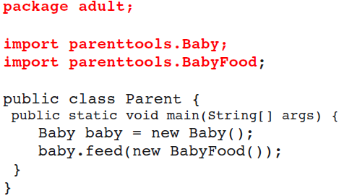
Class Structure - in general

Slide 12
Packages
Each class belongs to a package
Classes in the same package serve a similar purpose
Packages are just directories
Classes in other packages need to be imported

Slide 13
Defining-Using Packages
Package path.to.package.foo;
Class Foo {
}
Using packages
Import path.to.package.foo.Foo;
Import path.to.package.foo.*;
How about importing
Import path.to.*;

Slide 14
Why Packages
Combine similar functionality
org.boston.libraries.Library
org.boston.libraries.Book
Separate similar names
Shopping.list
Packing.List

Slide 15
Special Packages
All classes “see” classes in the same package (no import needed)
All classes “see” classes in java.lang
Math, String, Thread, Integer …
Example: java.lang.String; java.lang.System

Slide 16
Methods
A program that provides some functionality can be long and contains many statements
A method groups a sequence of statements and should provide a well-defined, easy-to-understand functionality
a method takes input, performs actions, and produces output
In Java, each method is defined within specific class

Slide 17
Method Declaration: Header
A method declaration begins with a method header
class MyClass
{
static int min ( int num1, int num2 )
…
method
name
parameter list
The parameter list specifies the type
and name of each parameter
The name of a parameter in the method
declaration is called a formal argument
return
type
properties

Slide 18
Method Declaration: Body
The header is followed by the method body:
class MyClass
{
…
static int min(int num1, int num2)
{
int minValue = num1 < num2 ? num1 : num2;
return minValue;
}
…
}

Slide 19
Methods That Return a Value
public int topla(int first, int second){
…
return 5; // 5 is an int value
}
example
int next = keyboard.nextInt();
keyboard is the calling object.

Slide 20
Defining Methods That Return a Value
example
public int fiveFactorial()
{
int factorial = 5*4*3*2*1;
return factorial;
}
As before, the method definition consists of the method heading and the method body.
The return type replaces void.

Slide 21
Methods That Do Not Return a Value
public void merhabaDE(String mesaj){
System.out.println(“Merhaba ”+mesaj);
}
The method invocation is a Java statement that produces the action(s) specified in the method definition.
It is as if the method invocation were replaced by the statements and declarations in the method definition.

Slide 22
void Method Definitions
Example
public void writeOuput(){
System.out.println(“Name: “ + name);
System.out.println(“Age: “ + age);
}
Such methods are called void methods.

Slide 23
Calling a Method
Each time a method is called, the values of the actual arguments in the invocation are assigned to the formal arguments
int num = min (2, 3);
static int min (int num1, int num2)
{
int minValue = (num1 < num2 ? num1 : num2);
return minValue;
}

Slide 24
Method Control Flow
A method can call another method, who can call another method, …
main
min(num1, num2, num3)
println()
min(1, 2, 3);
…println(…)

Slide 25
Method Overloading
A class may define multiple methods with the same name---this is called method overloading
usually perform the same task on different data types
Example: The PrintStream class defines multiple println methods, i.e., println is overloaded:
println (String s)
println (int i)
println (double d)
…
The following lines use the System.out.print method for different data types:
System.out.println ("The total is:");
double total = 0;
System.out.println (total);

Slide 26
Method Overloading: Signature
The compiler must be able to determine which version of the method is being invoked
This is by analyzing the parameters, which form the signature of a method
the signature includes the type and order of the parameters
if multiple methods match a method call, the compiler picks the best match
if none matches exactly but some implicit conversion can be done to match a method, then the method is invoke with implicit conversion.
the return type of the method is not part of the signature

Slide 27
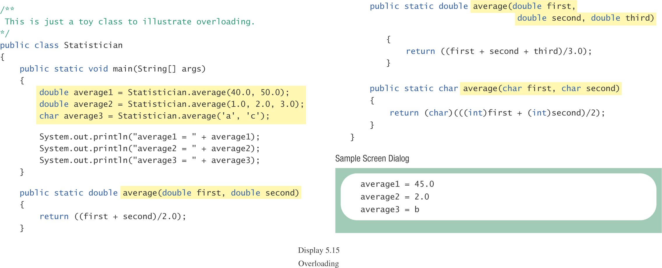

Slide 28
Method Overloading
Version 1
Version 2
double tryMe (int x)
{
return x + .375;
}
double tryMe (int x, double y)
{
return x * y;
}
Invocation
result = tryMe (25, 4.32)

Slide 29
More Examples
double tryMe ( int x )
{
return x + 5;
}
Which tryMe will be called?
tryMe( 1 );
tryMe( 1.0 );
tryMe( 1.0, 2);
tryMe( 1, 2);
tryMe( 1.0, 2.0);
double tryMe ( double x )
{
return x * .375;
}
double tryMe (double x, int y)
{
return x + y;
}
Notes:
1 int
2 double
3 double ve int
4 double ve int
5 çalışmaz

Slide 30
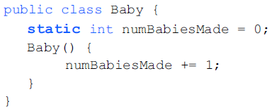
Static Types and Methods
NOT unique for each instance
They belong to the class, not specific objects of that class. An example from the java API is Math, all the variables are static.
Example case:
Keep track of the number of babies that have been made

Slide 31
Static Methods
Some methods have no meaningful connection to an object. For example,
finding the maximum of two integers
computing a square root
converting a letter from lowercase to uppercase
generating a random number
Such methods can be defined as static.

Slide 32
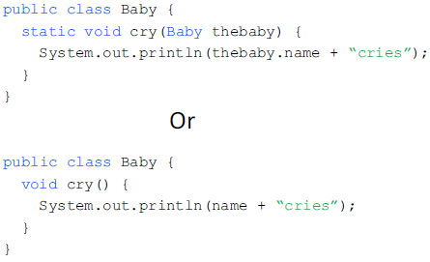
Static Method

Slide 33
Static Methods, cont.
A static method is still defined as a member of a class.
But, the method is invoked using the class name rather than an object name.
syntax
return_Type Variable_Name =
Class_Name.Static_Method_Name(Parameters);

Slide 34
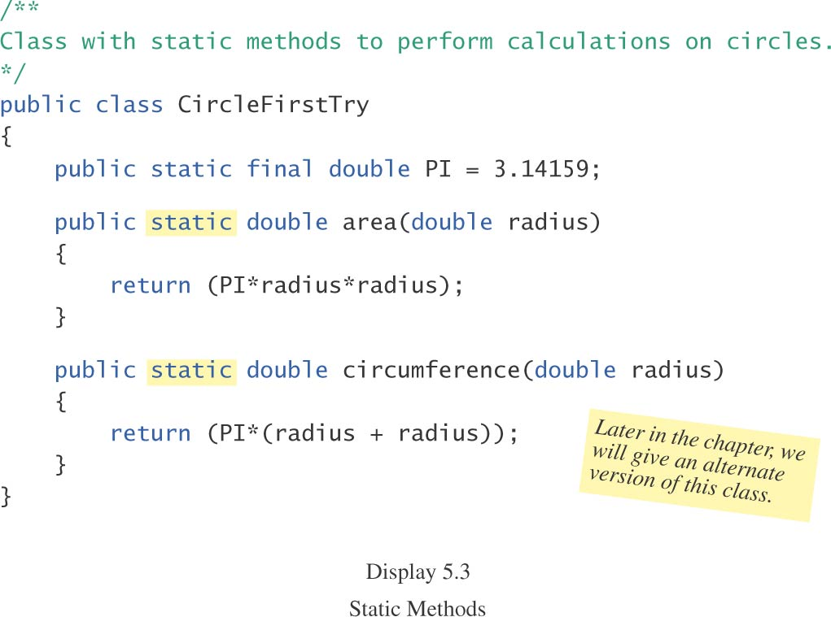

Slide 35
Using an Object to Call a Static Method
An object of the class can be used to call a static method of the class even though it is more common to use the class name to call the static method.
You cannot invoke a nonstatic method within a static method unless you create and use a calling object for the nonstatic method.

Slide 36
Scope

Slide 37
Local Variables
A variable declared within a method is called a local variable.
Its meaning is “local to” (confined to) the method definition.
Variables with the same name declared within different methods are different variables.
A local variable exists only as long as the method is active.

Slide 38
Blocks Variables
The terms block and compound statement both refer to a set of Java statements enclosed in braces {}.
A variable declared within a block is local to the block.
When the block ends, the variable disappears.
If you intend to use the variable both inside and outside the block, declare it outside the block.

Slide 39
Variables in for Statements
The loop control variable can be declared outside the for statement
int n;
for (n = 1; n <10, n++)
in which case the variable n still exists when the for statement ends
The loop control variable can be declared inside the for statement
for (int n = 1; n <10, n++)
in which case the variable n ceases to exist when the for statement ends
(a) problem (b) ok
int i=5;
for (int i = 1; i <10, i++){} for (int i = 1; i <10, i++){}
int i=5;

Slide 40
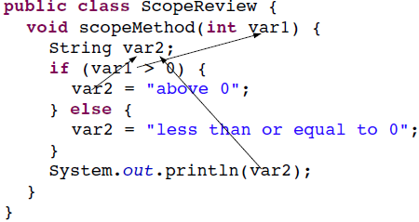
Method Scope

Slide 41
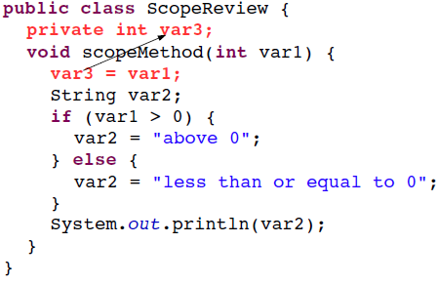
Class Scope
Notes:
Var1 adı var3 olabilir.
Method parametresi var1’i var3 yapsak ne olur?
Method içinde artık var3 methoda parametre verilendir. Class scope una ulaşmak için this.var3 kullanmak gerekir.

Slide 42
Scope
Just like methods, variables are accessible inside {}
void method(int arg1){
int arg2 = arg1 + 1;
}
Class Example{
int memberVariable;
void setVariable(int newVal) {
memberVariable += newVal;
}
}
Notes:
No prob

Slide 43
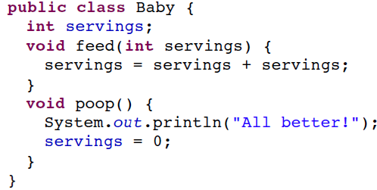
Only method-level ‘servings’ variable is updated
Notes:
No prob

Slide 44
‘this’ keyword
Clarifies scope
Means ‘my object’
Usage:
Class Example{
int memberVariable;
void setVariable(int newVal) {
this.memberVariable += newVal;
}
}
Notes:
No prob

Slide 45
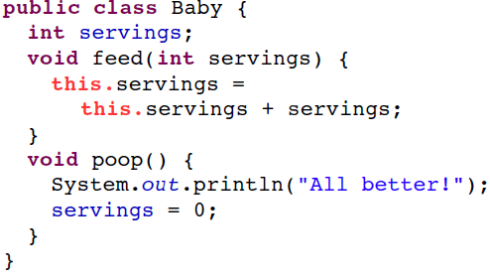
Object-level ‘servings’ is updated

Slide 46
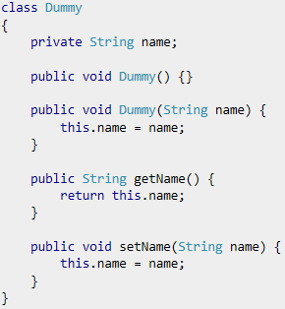
Setters and Getters Methods in Class
For the attribute called name
Getter method is getName
Setter method is setName
Getter access-get the value of attribute
Setter sets-change the value of the attribute

Slide 47
Exercises for scopes

Slide 48
Does it run?
class Main {
int klm;
public static void main(String args[]) {
System.out.println("klm: " + klm);
}
}
class Main {
int klm;
public static void main(String args[]) {
Main m = new Main();
System.out.println("klm: " + m.klm);
}
}
Notes:
- hayir cunku nonstatic variable klm cannot be referenced from a static method.
-Calisir ve 0 basar.

Slide 49
Does it run?
class Main {
int klm;
public static void main(String args[]) {
int klm;
Main m = new Main();
System.out.println("klm: " + klm);
}
}
class Main {
int [] klm = new int[5];
public static void main(String args[]) {
Main m = new Main();
System.out.println("klm: " + m.klm[0]);
}
}
Notes:
-Calismaz.
Exception in thread "main" java.lang.RuntimeException
- Calisir 0 basar.

Slide 50
Does it run?
class Main {
String [] klm = new String[5];
public static void main(String args[]) {
Main m = new Main();
System.out.println("klm: " + m.klm[0]);
}
}
for(int i=0; i<5; i++){
System.out.println("i: "+i);
}
System.out.println("i: "+i);
Notes:
- Calisir null basar
-cannot find symbol i

Slide 51
Does it run?
int i;
for(int i=0; i<5; i++){
System.out.println("i: "+i);
}
System.out.println("i: "+i);
int i;
for(i=0; i<5; i++){
System.out.println("i: "+i);
}
System.out.println("i: "+i);
Notes:
i is already defined
i: 0
i: 1
i: 2
i: 3
i: 4
i: 5

Slide 52
Backup

Slide 53
Primitives vs References
Primitive types are basic java types
int, long, double, boolean, char, short, byte, float
The actual values are stored in the variable
Reference types are arrays and objects
String, int[], Baby, Automobile

Slide 54
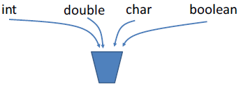
How java stores primitives
Variables:
Variables are like fixed size cups
Primitives are small enough that they just fit into the cup

Slide 55
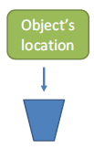

How Java Stores primitives and Objects
Objects:
Objects are too big to fit in a variable
Stored somewhere else
Variable stores a number that locates the object
The object’s location is called a reference
== compares the references

